Slide 1
Ana Isabel Lage Ferreira
Chair, DD
District 107 Council Meeting (DCM)
Athens, 26 May 2018

Slide 2
Pablo Garcia Parliamentarian
District 107 Council Meeting (DCM)
Athens, 26 May 2018
Parliamentary
Procedure

Slide 3
14:00 I. Opening
A. Call to Order Ana Isabel Ferreira
B. District Mission Clara Noble
C. Certification of Quorum Clara Noble
D. Parliamentary Procedure Pablo Garcia
E. Adoption of Agenda Ana Isabel Ferreira
14:20 II. Current Business
A. Alignment report Ana Isabel Ferreira
14:20 III. Elections
A. Introduction Ana Isabel Ferreira
B. DLC Report Norberto Amaral
C. DD, PQD, CGD, PRM Ana Isabel Ferreira
G. Division Directors Ana Isabel Ferreira
15:40 IV. New Business
A. Fall Event 2018 Nacho Arenas
B. Business Meeting Calendar Nelson Emílio
16:00 V. Closing / Adjournment Ana Isabel Ferreira

Slide 4
Ana Isabel Ferreira Alignment Chair /Rep
District 107 Council Meeting (DCM)
Athens, 26 May 2018
Alignment
Report

Slide 5
Ana Isabel Ferreira Alignment Chair /Rep
Alignment 2018 -19

Slide 6
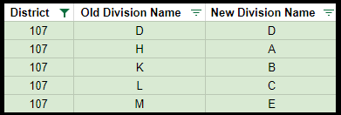
New Division Names
District 59 I DECM May 2018

Slide 7
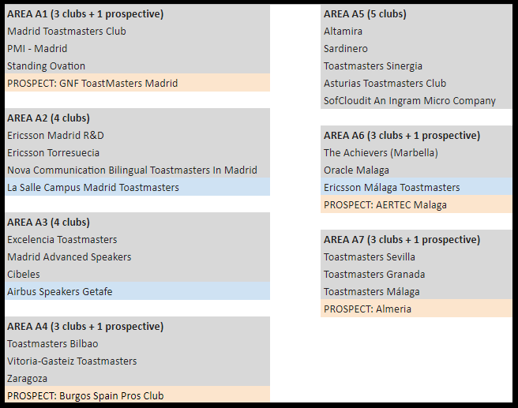
Division H Division A
2 new areas
District 59 I DECM May 2018

Slide 8
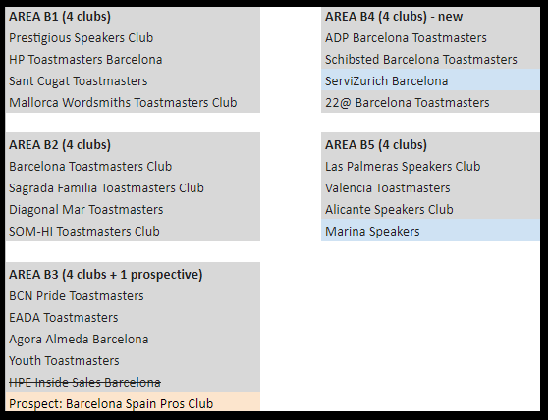
Division K Division B
new area
District 59 I DECM May 2018

Slide 9
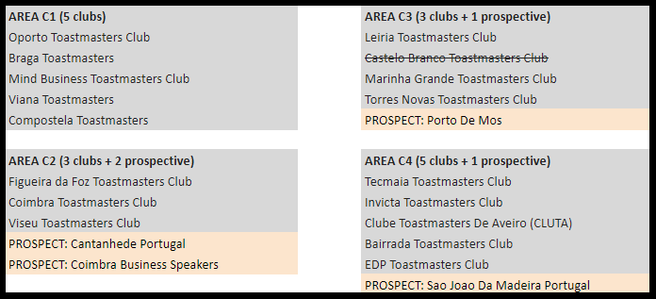
Division L Division C
Reshuffle
District 59 I DECM May 2018

Slide 10
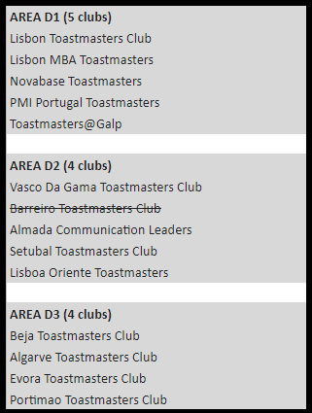
Division D Division D
Lisboa Oriente moves
District 59 I DECM May 2018

Slide 11
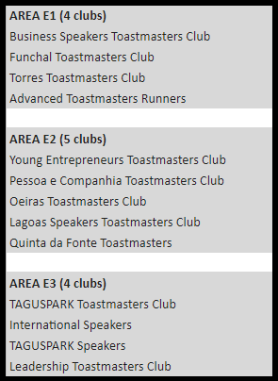
Division M Division E
no change
District 59 I DECM May 2018

Slide 12
Let’s vote ...
District 59 I DECM May 2018

Slide 13
District 107 Council Meeting (DCM)
Athens, 26 May 2018
Election
Procedure

Slide 14
Protocol 9.11
DD, PQD, CGD, PRM, Division Directors; alphabetical order
Additional nominations from the floor
Eligibility
Nominations closed
More than one candidate: speeches
Balloting
Voting per position
Non- elected candidates
Majority of the votes cast
Observer
Final results

Slide 15
Norberto Amaral DLC-Chair /rep
District 107 Council Meeting (DCM)
Athens, 26 May 2018
District Leadership Committee Report

Slide 16
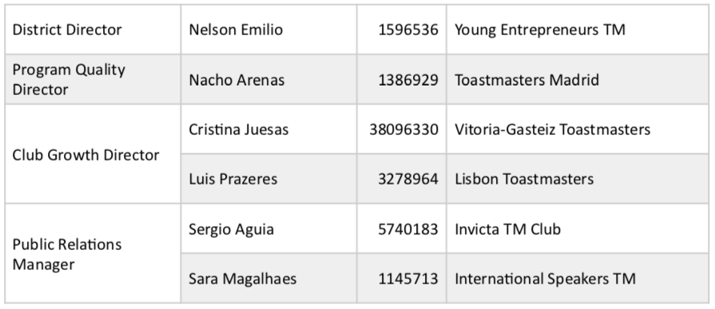
Coreteam

Slide 17
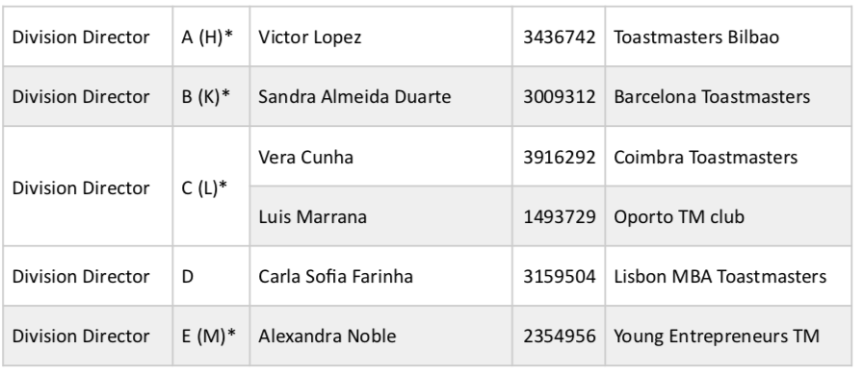
Division Directors

Slide 18
District 107 Council Meeting (DCM)
Athens, 26th May 2018
Elections

Slide 19
District Director
As the district’s chief executive officer, direct the district in a way which fosters strong clubs; produce maximum growth in education completions, clubs and membership; and be consistent with the interests of members of Toastmasters International. Motivate the district to achieve Distinguished recognition. Achieve the mission of the district in a manner that motivates volunteer leaders and promotes a standard of excellence in all district activities.
Qualifications
At the time of taking office, the district director shall have served at least six consecutive months as a club president and at least 12 consecutive months as a program quality director, club growth director or division director or a combination thereof.

Slide 20
District Director
Nelson Emílio

Slide 21
Program Quality Director
Under the guidance of the district director, strive to have every club and each member reap the benefits of Toastmasters and to have every club become Distinguished. Provide direction and counsel to division directors, area directors and club officers on the educational opportunities in Toastmasters. Design and conduct successful district training programs, conferences, and other district educational events.
Qualifications
At the time of taking office, the program quality director shall have served at least six consecutive months as a club president and at least 12 consecutive months as a program quality director, club growth director, division director or area director or a combination thereof.

Slide 22
Program Quality Director
Nacho Arenas

Slide 23
Club Growth Director
Under guidance of the district director, make the benefits of Toastmasters membership available to greater numbers of people. Plan, develop, implement, and direct district marketing objectives. Develop and direct programs for new club development, club rescue efforts, club membership promotion, and membership retention. Achieve Distinguished District goals for membership and club growth. Promote standards of service to the member and to the club.
Qualifications
At the time of taking office, the club growth director shall have served at least six consecutive months as a club president and at least 12 consecutive months as program quality director, club growth director, division director, area director or a combination thereof.

Slide 24
Club Growth Director
Cristina Juesas
Luís Prazeres

Slide 25
Public Relations Manager
Under the direction of the district director, help maintain communication between the district and its members and work to increase public awareness of Toastmasters International through the media. Prepare a public relations program designed to achieve goals for membership growth, club growth, and educational achievements in clubs and achievement in the Distinguished Club Program. Promote district conferences and leadership training opportunities within the district.
Qualifications
At the time of taking office, the public relations manager should possess experience in and core understanding of public relations.

Slide 26
Public Relations Manager
Sara Magalhães
Sérgio Águia

Slide 27
Division Directors
Achieve the mission of the district within the division, accomplishing district goals in membership building and retention, club extension, and educational accomplishments. Ensure that each club realizes its mission and fulfills its responsibilities to members. Achieve Distinguished Division Program goals and ensure that areas and clubs within the division achieve Distinguished recognition. Serve the division clubs by providing district support and resources through the area directors.
Qualifications
At the time of taking office, the division director shall have served at least six consecutive months as a member of a district council.

Slide 28
Division A Director
Victor Lopez

Slide 29
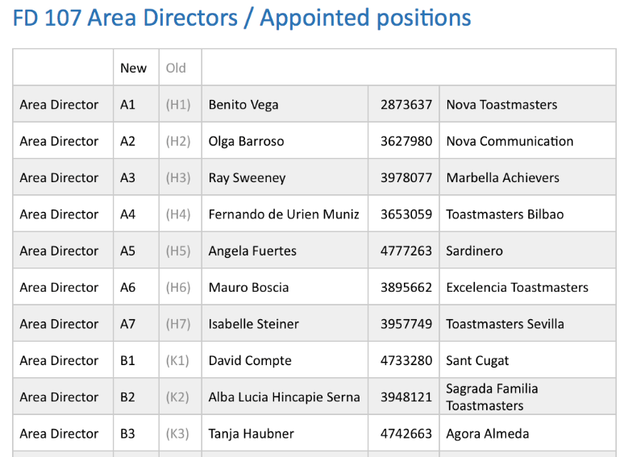
Division A

Slide 30
Division B Director
Sandra Almeida Duarte

Slide 31
Division B

Slide 32
Division C Director
Vera Cunha
Luís Marrana

Slide 33
Division C

Slide 34
Division D Director
Carla Sofia Farinha

Slide 35
Division D

Slide 36
Division E Director
Alexandra Noble

Slide 37
Division E

Slide 38
Nelson Emílio
District 107 Council Meeting (DCM)
Athens, 26 May 2018
Fall event

Slide 39
Nelson Emílio
District 107 Council Meeting (DCM)
Athens, 26 May 2018
Business Calendar

Slide 40
Ana Isabel Ferreira
District 107 Council Meeting (DCM)
Athens, 26 May 2018
Adjournment

